Slide 1
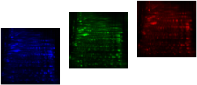
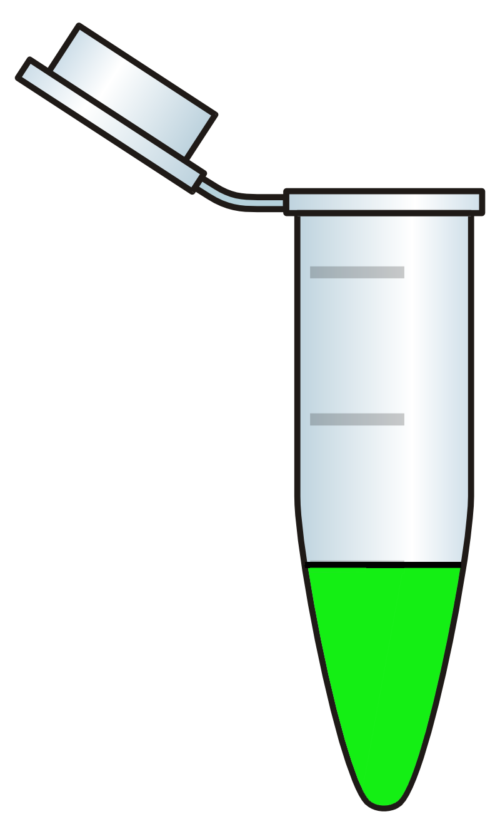
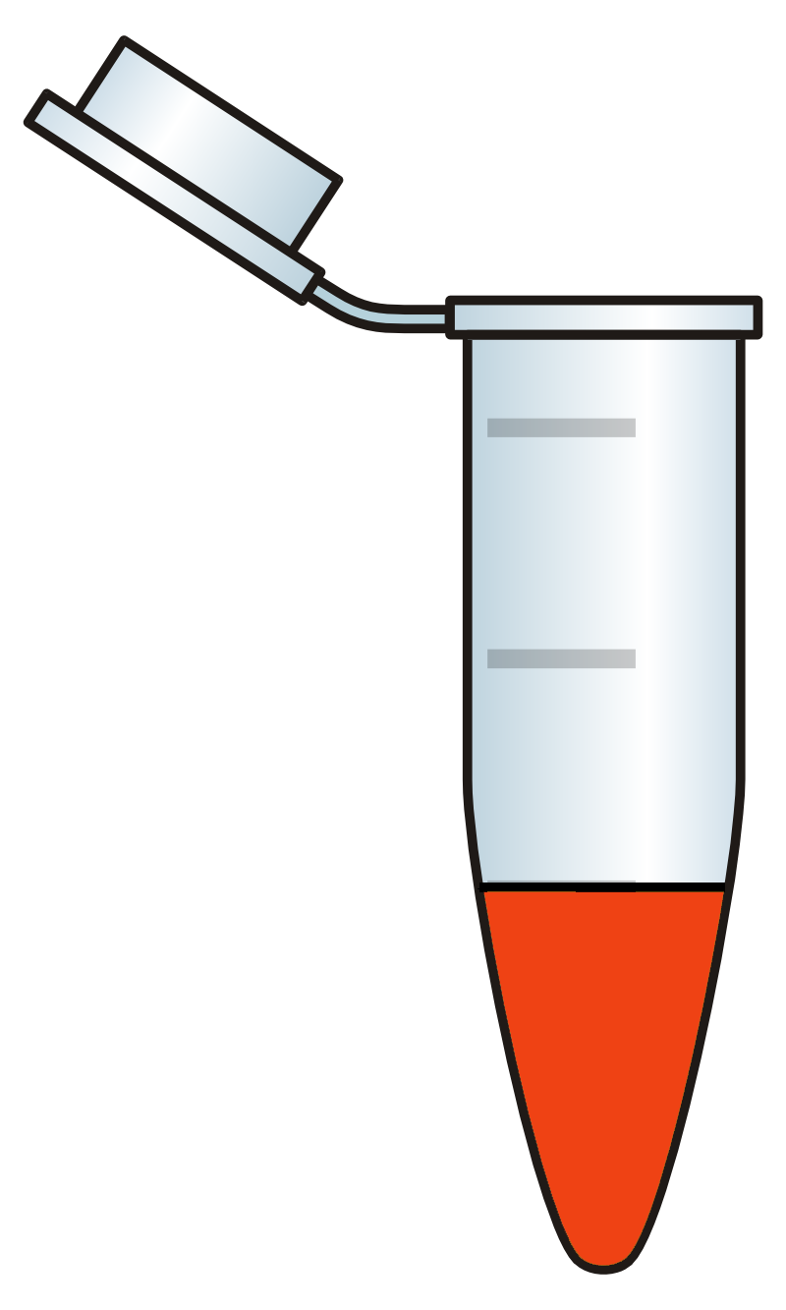
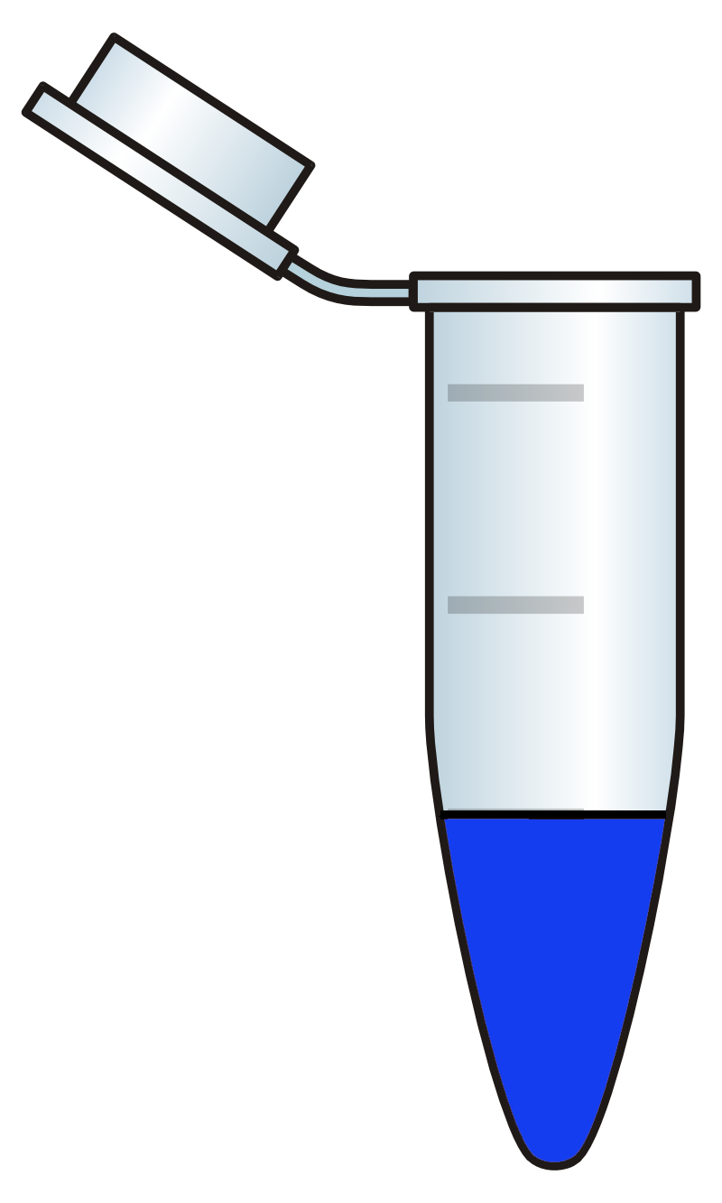
Monitoring protein carbonylation : 2D C=ODIGE
Cy5-NHS
Cy2-NHS
C=O
Treated
P
C=O
IS
C=O
Control
P
C=O
IS
+
Cy3-Hz
IS
Protein Mix
Notes:
<number>

Slide 2
Protein carbonylation as marker of diseases
Oxidative damage
DNA
Lipids
Proteins
ROS
Antioxidant
(GSH,SOD,CAT)
Cell death-Tissue Injury
Aging, Degeneration&
Diseases
<number>
Dalle Donne, J. Cell. Mol. Med. Vol 10, No 2, 2006 pp. 389-406

Slide 3
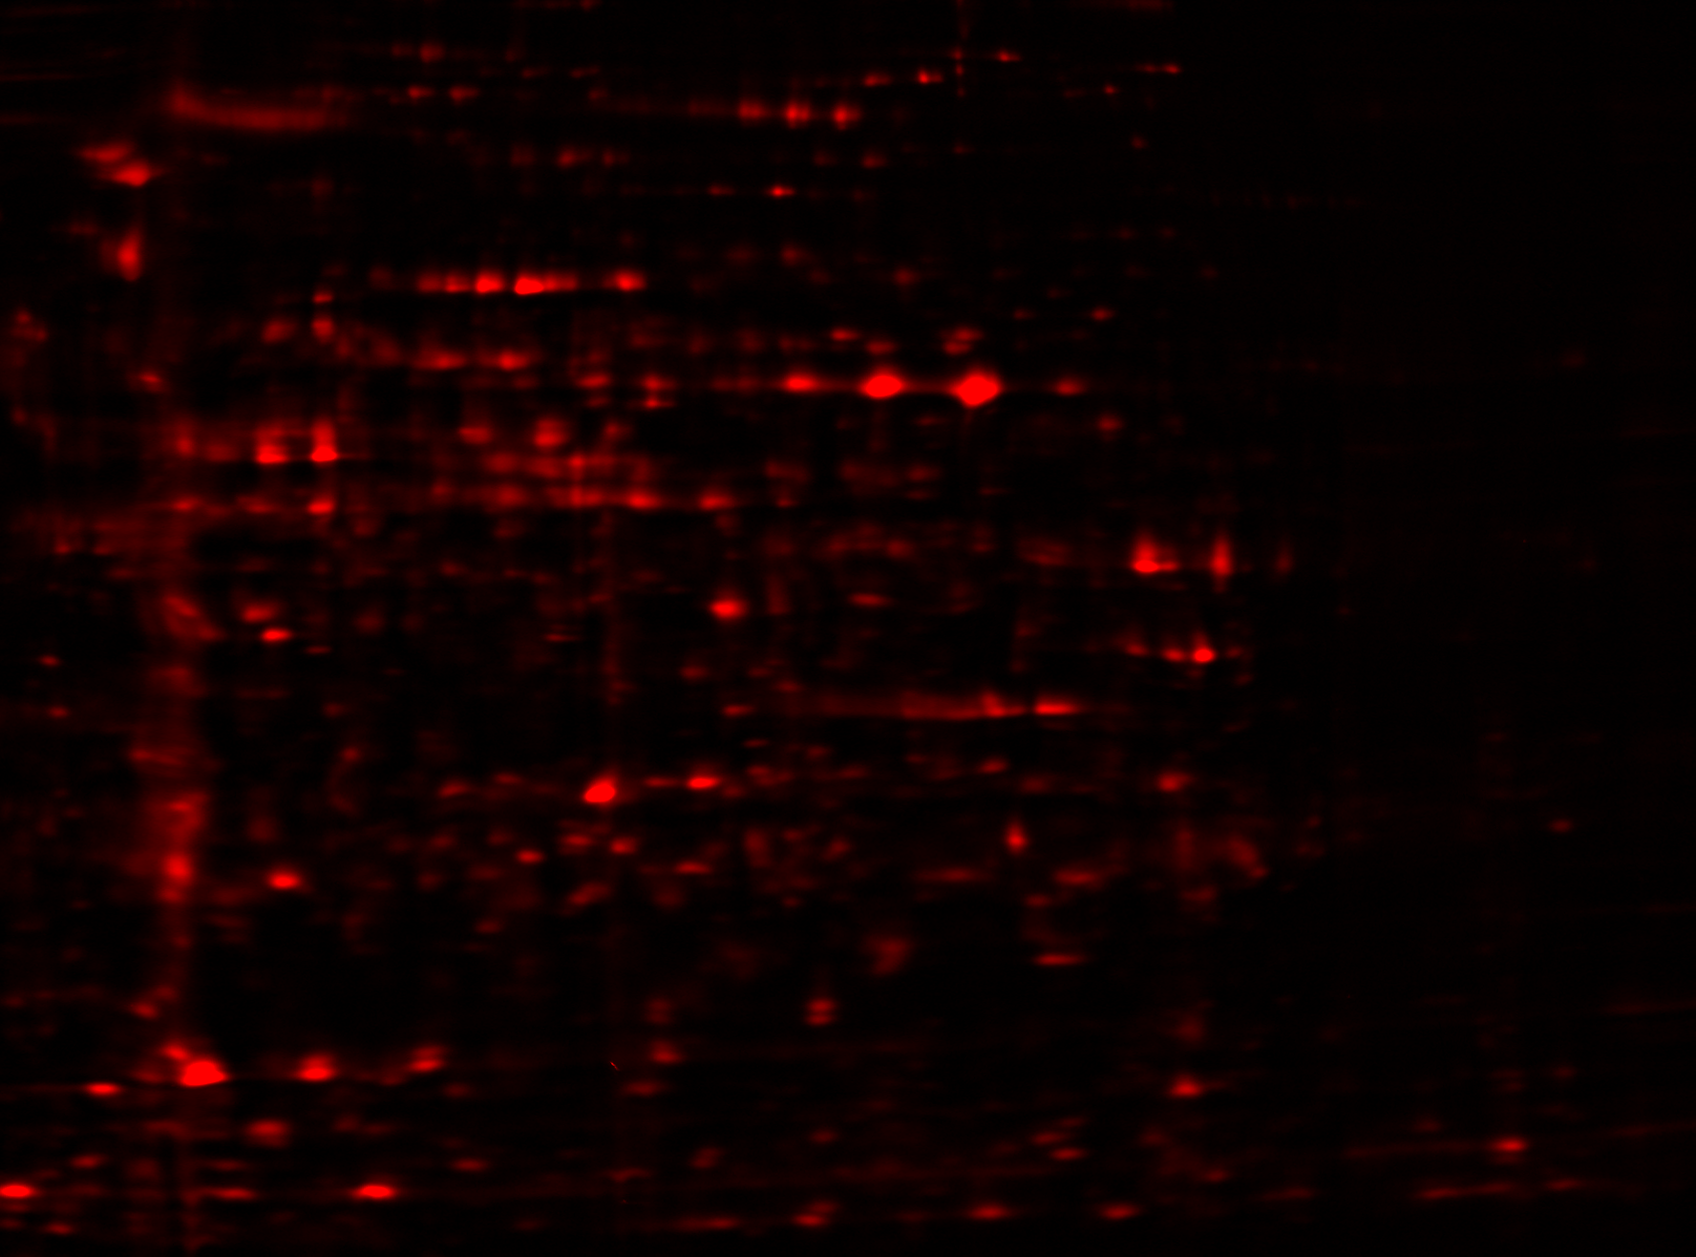
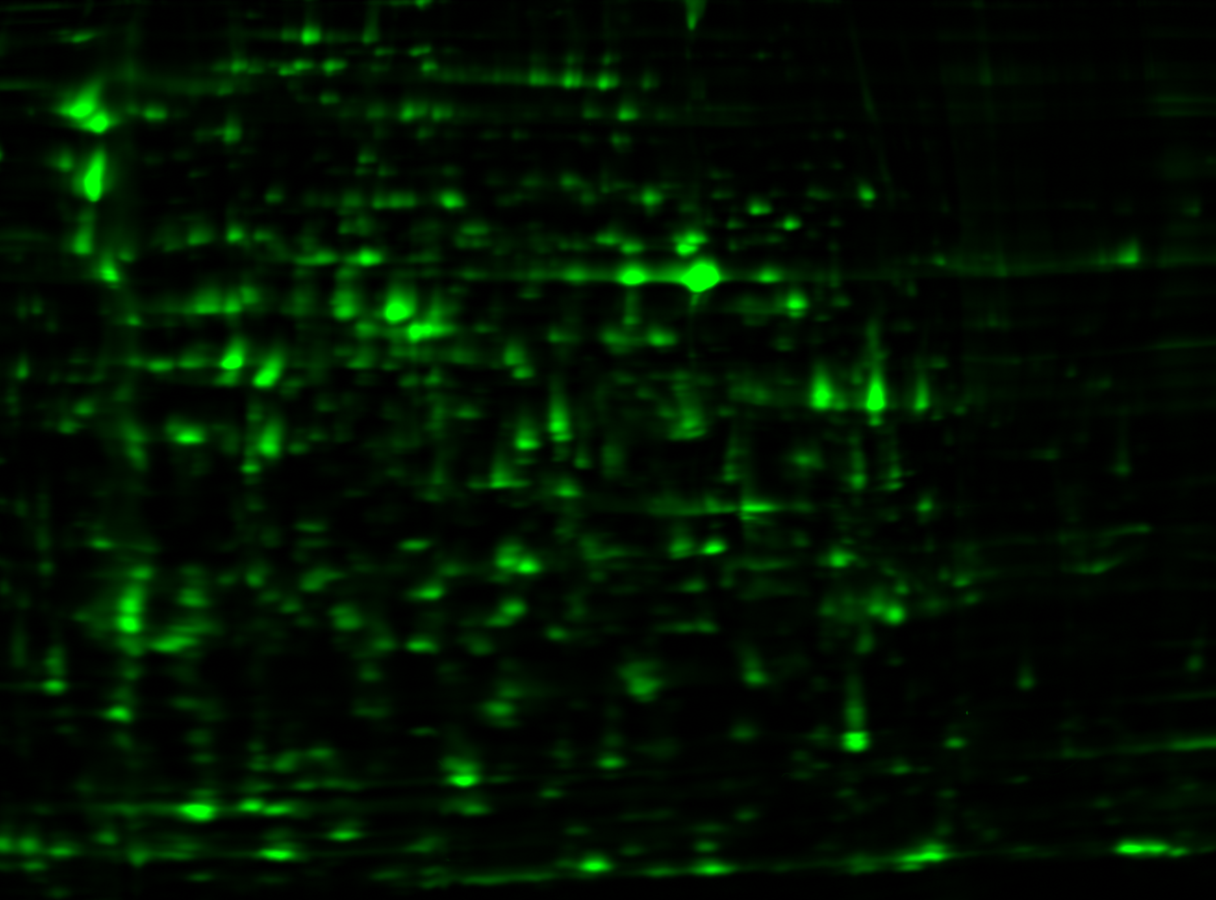
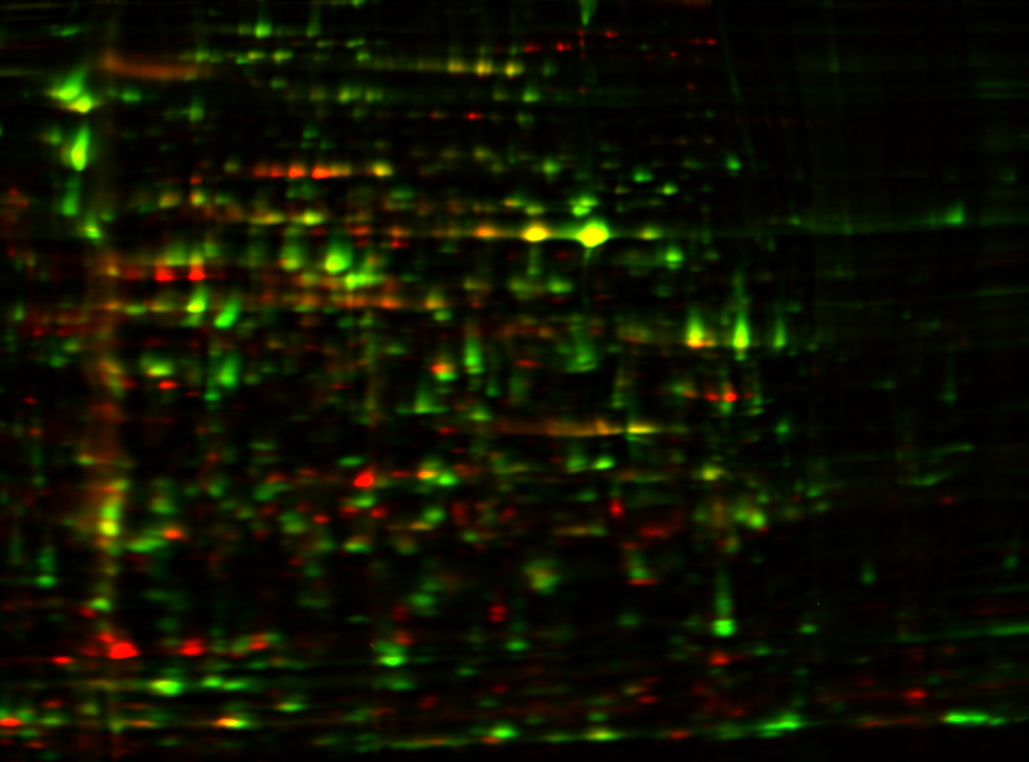
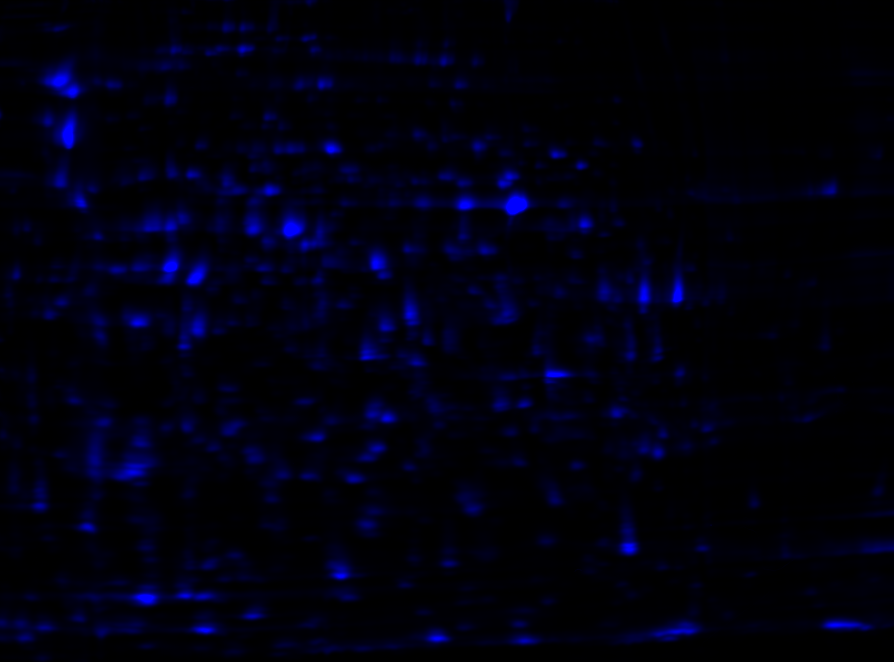
Protein Oxidative damage, 2D C=O DIGE
3
pH
10
150
carbonyl
carbonyl
MW
Protein
Protein
IS
15
IS
E. coli carbonylome
E. coli carbonylome

